Slide 1
PROJECT : EVENTS INFO PAGE
SUBMITTED BY : TEAM 43
OVERVIEW :
In a popular college like ours, multiple Events are organised in the campus every week. However, due to a lack of common medium, people often miss out on the important of details such as date of event, venue etc. To solve this problem, we have built a Web App on which everyone can easily find out about the various Events being held in the college.

Slide 2
Solution Description :
On this Web App:
1.The event organizers or the admins can create new events, update and delete events.
2.Students can see events segreagated into three categories: past, currrent and future
events. To be reminded for an pqrticular event they can save an upcoming event to
their personal calendar using our Add to Calendar method. They can also search for a
particular event using the search feature.
Features :
1. Addition, updation and deletion of events.
2. Classification of events into: past, current and upcoming.
3. Countdown Timer
4. [Bonus ]: Add to personal calendar for receiving remminder about an event
5. [Bonus ]: Search for a particular event using the search bar.
6. Persistent data storage.
7. Responsive to both Desktop and Mobile screens.

Slide 3
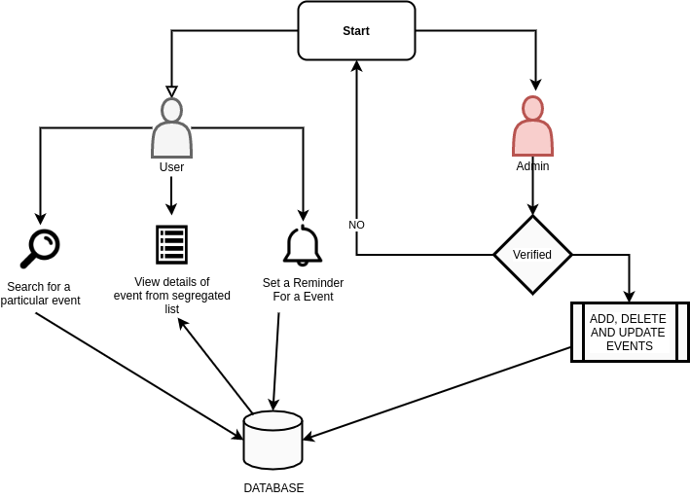
WORKFLOW :

Slide 4
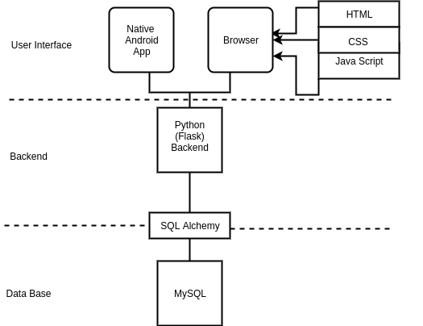
TECHNOLOGY STACK :

Slide 5
USE CASE :
ADMIN :
Can create new events, update and delete events.
STUDENT:
View segregated events from past, current and future
Can set a reminder for a particular event .
Search for a particular event using the search feature.

